Slide 1
Little More on GAN

Slide 2
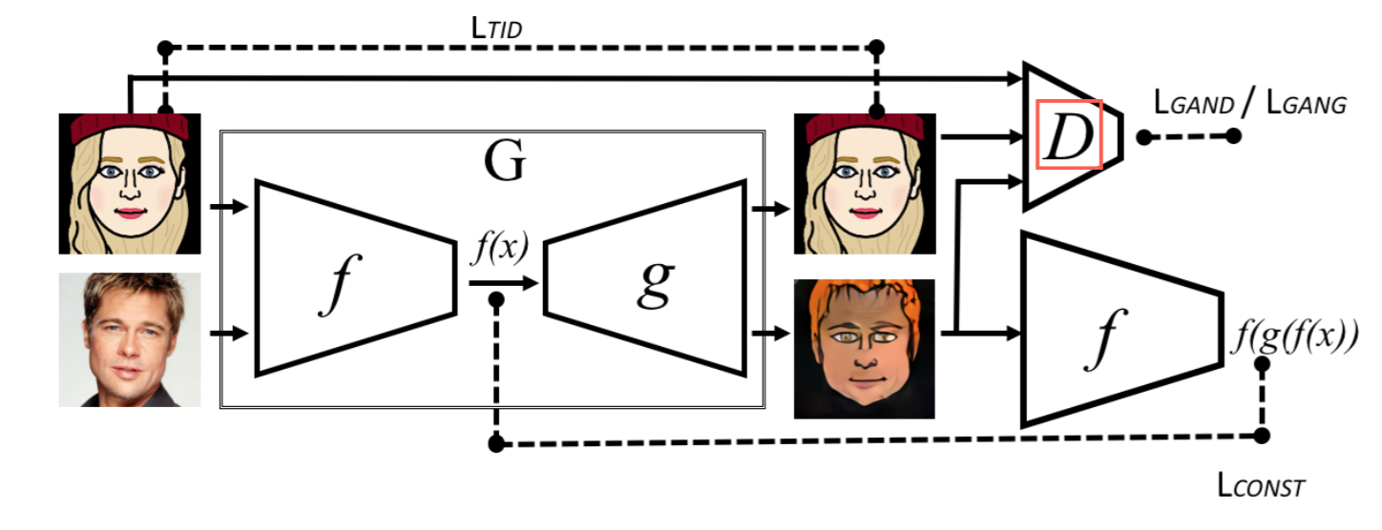
Domain Transfer Network
UNSUPERVISED CROSS-DOMAIN IMAGE GENERATION

Slide 3
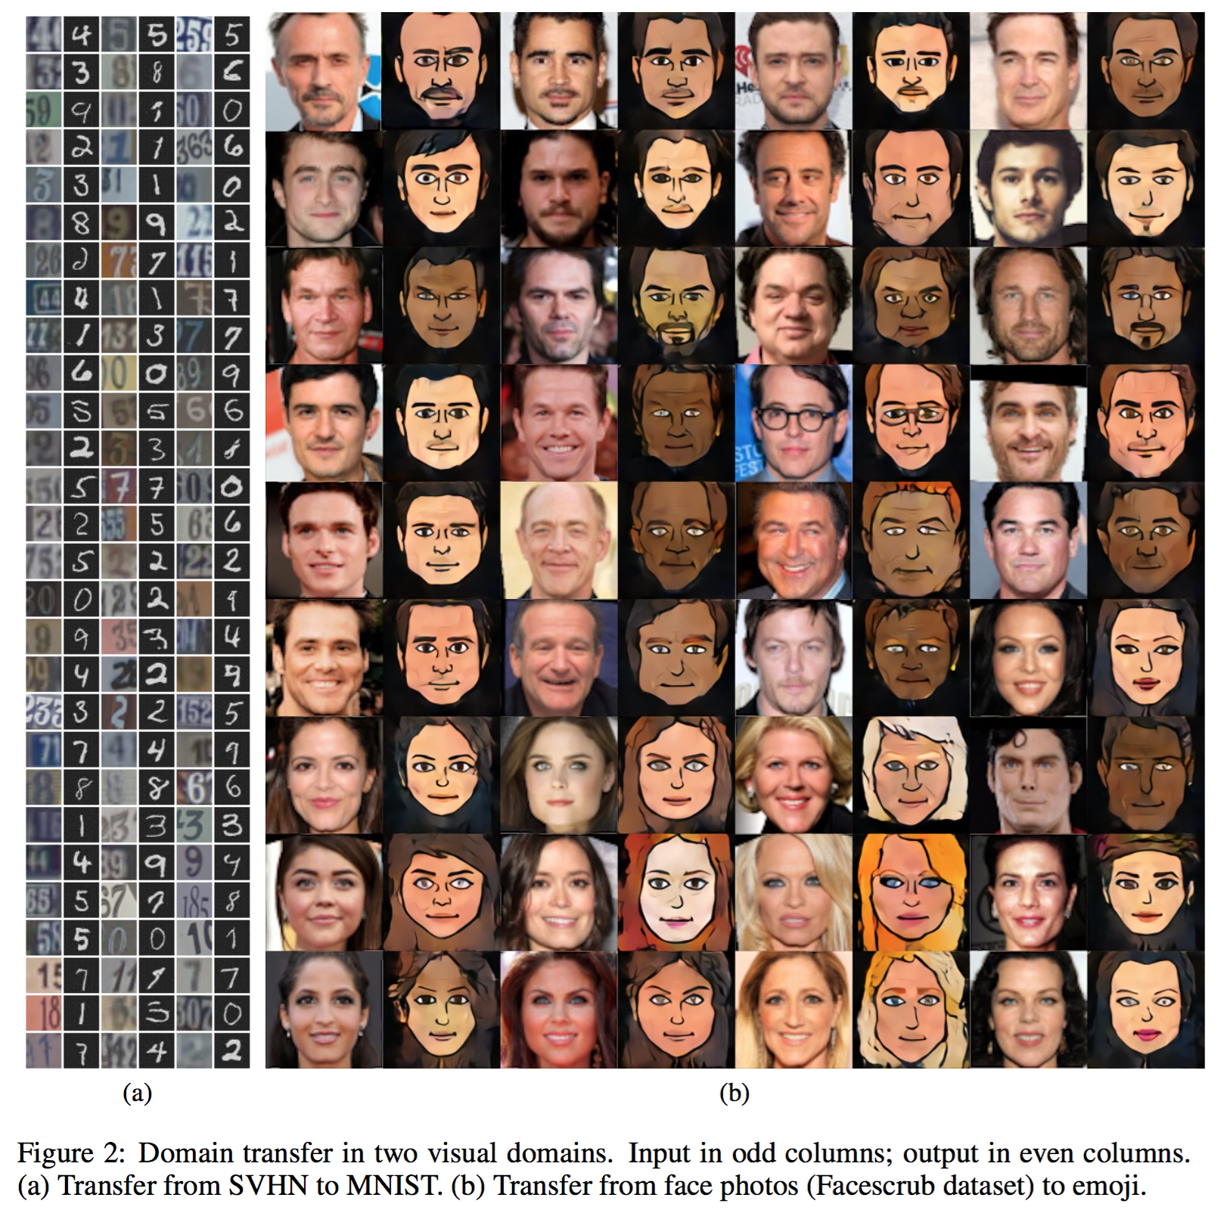
Domain Transfer Network
UNSUPERVISED CROSS-DOMAIN IMAGE GENERATION

Slide 4
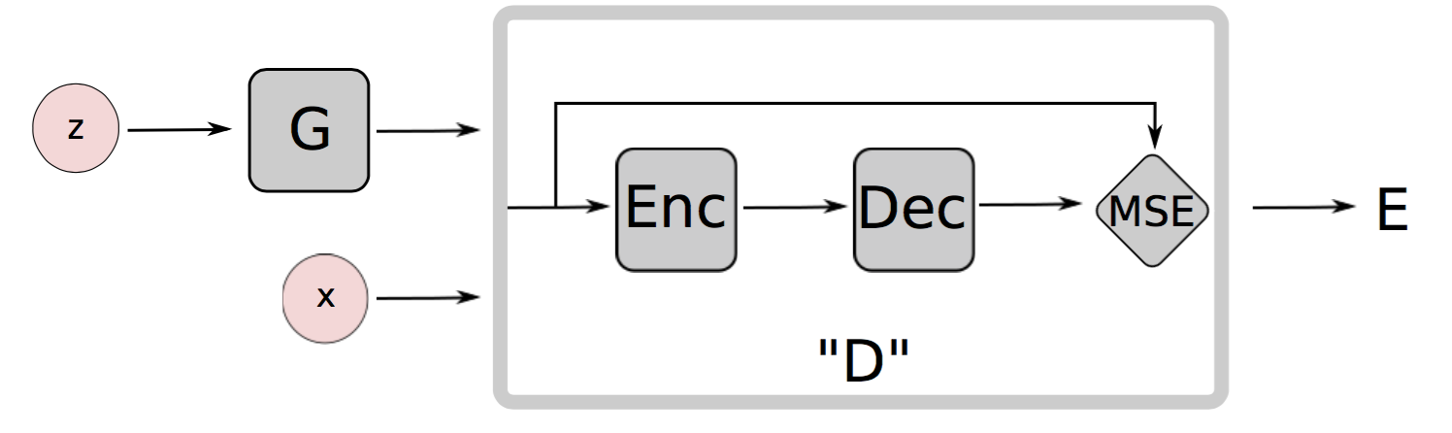
Energy-Based GAN
ENERGY-BASED GENERATIVE ADVERSARIAL NETWORKS

Slide 5
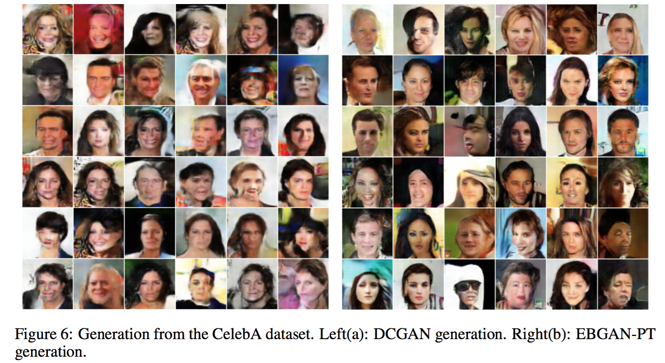
Energy-Based GAN
ENERGY-BASED GENERATIVE ADVERSARIAL NETWORKS

Slide 6
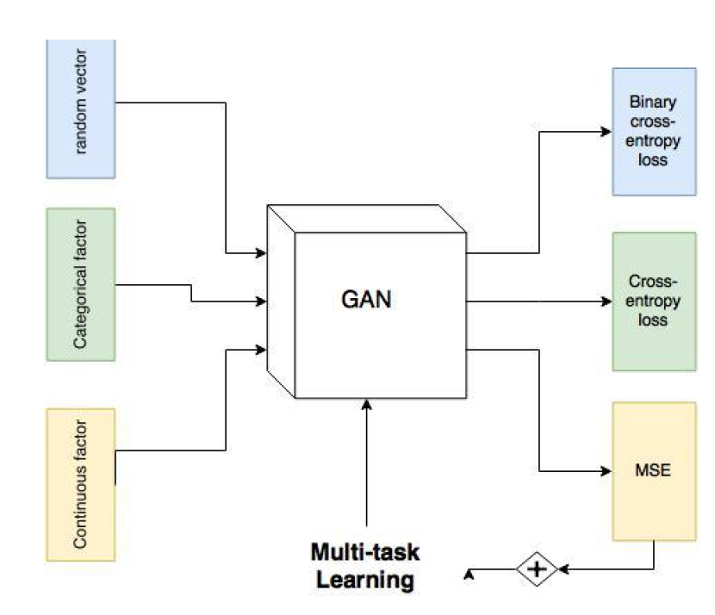
InfoGAN
InfoGAN: Interpretable Representation Learning by Information Maximizing Generative Adversarial Nets

Slide 7
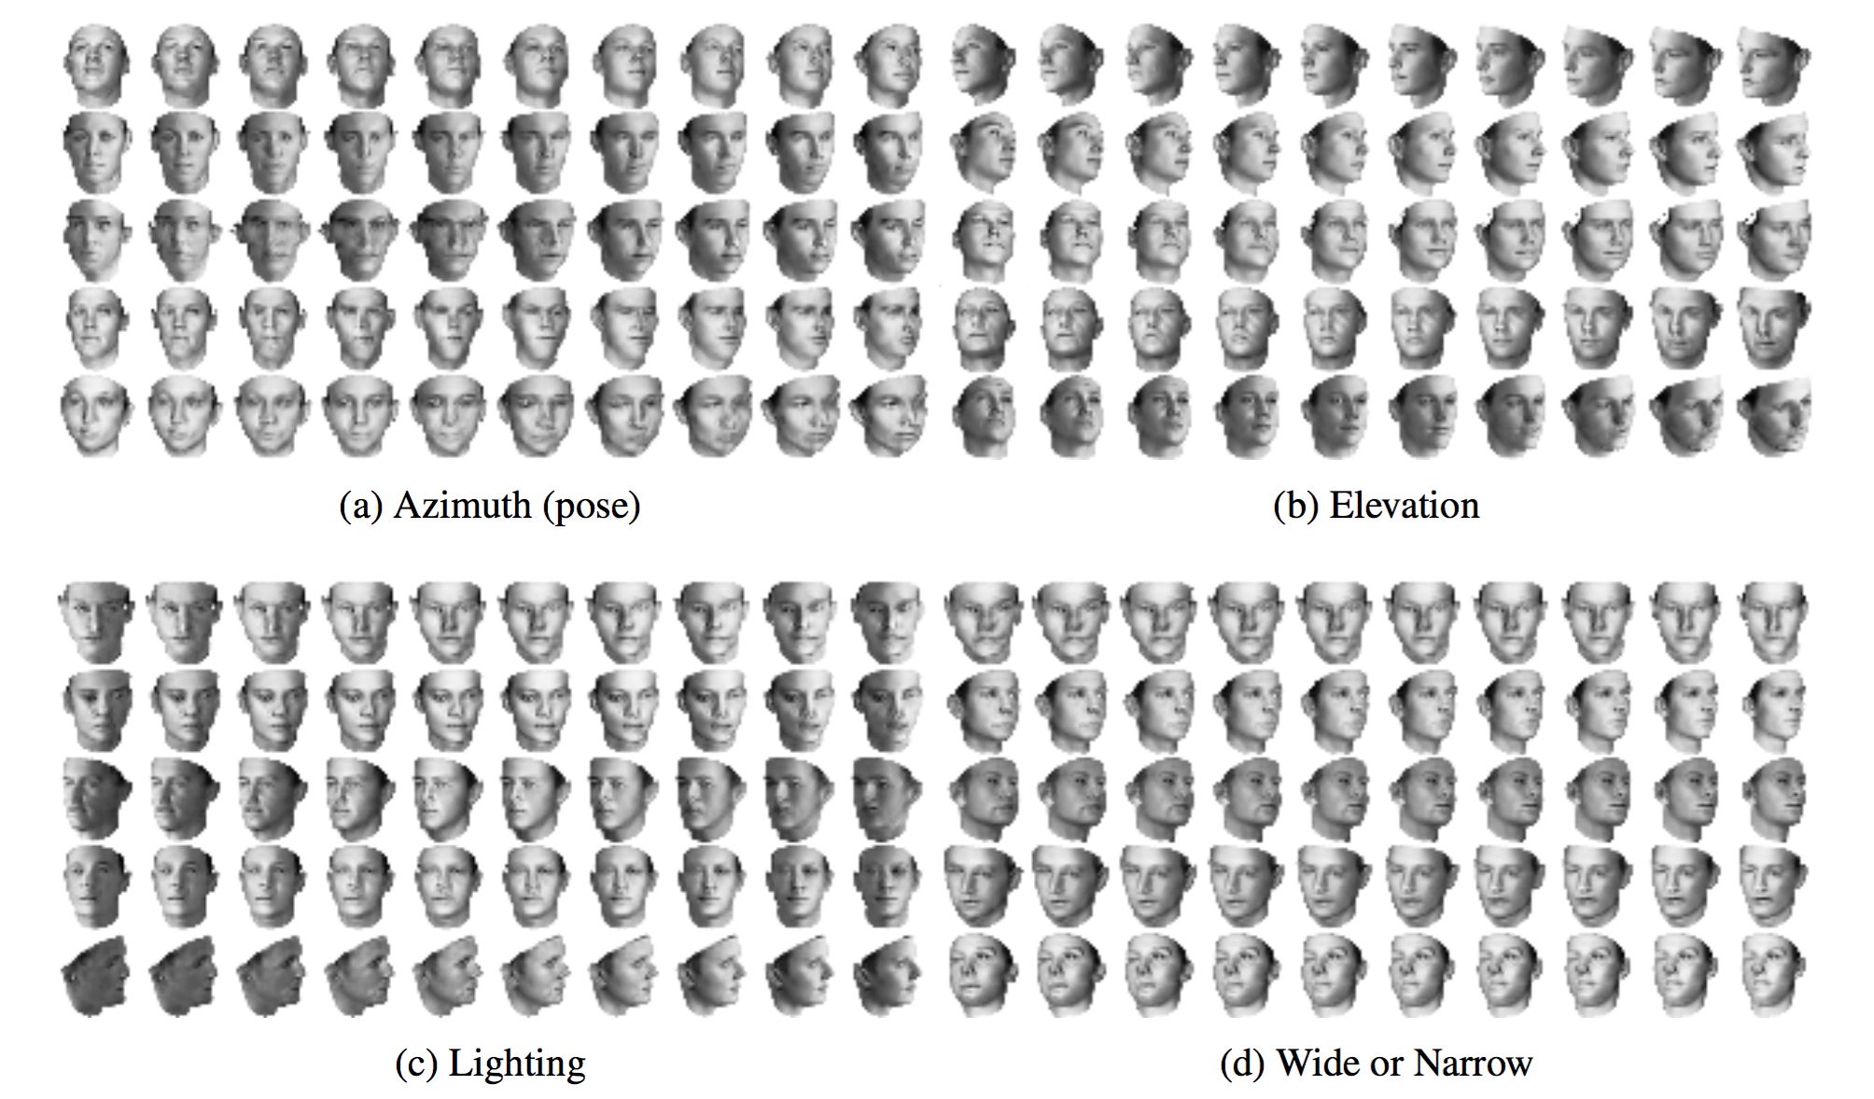
InfoGAN
InfoGAN: Interpretable Representation Learning by Information Maximizing Generative Adversarial Nets

Slide 8
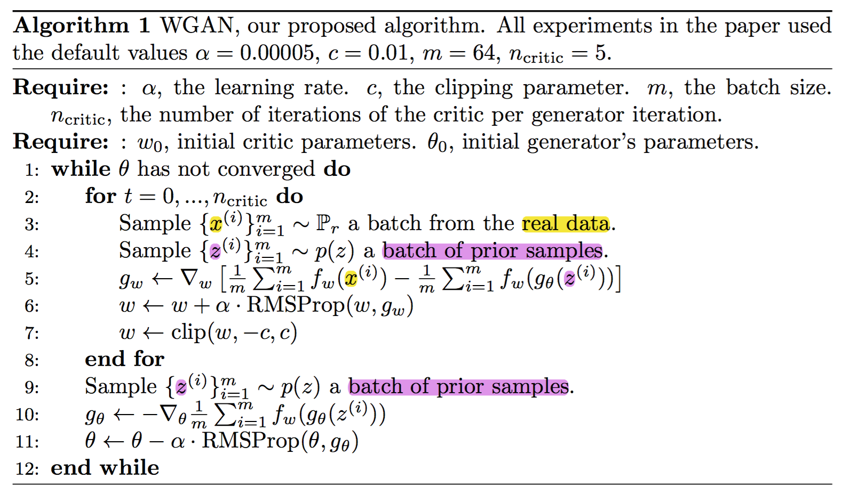
WGAN
^{Wasserstein GAN}

Slide 9
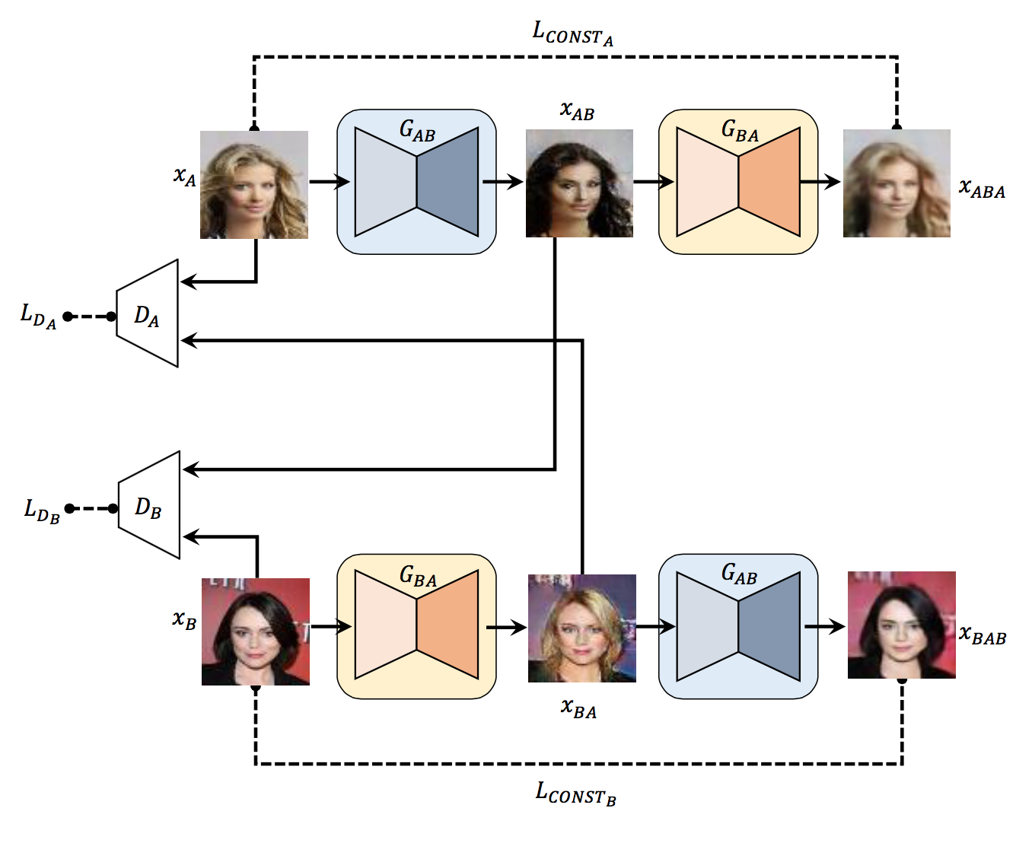
DiscoGAN
Learning to Discover Cross-Domain Relations with Generative Adversarial Networks

Slide 10
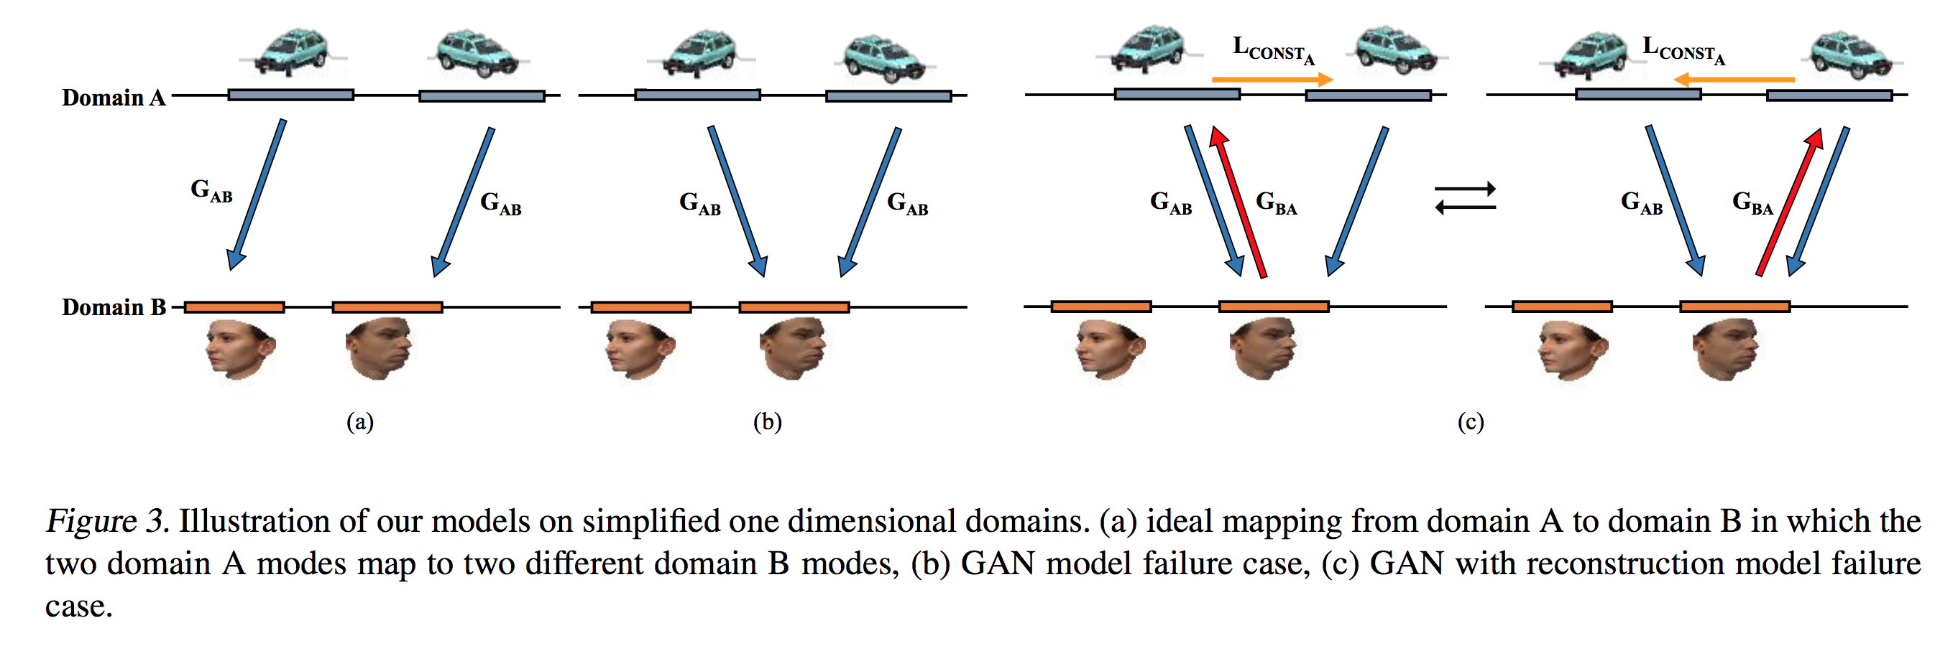
DiscoGAN
Learning to Discover Cross-Domain Relations with Generative Adversarial Networks

Slide 11
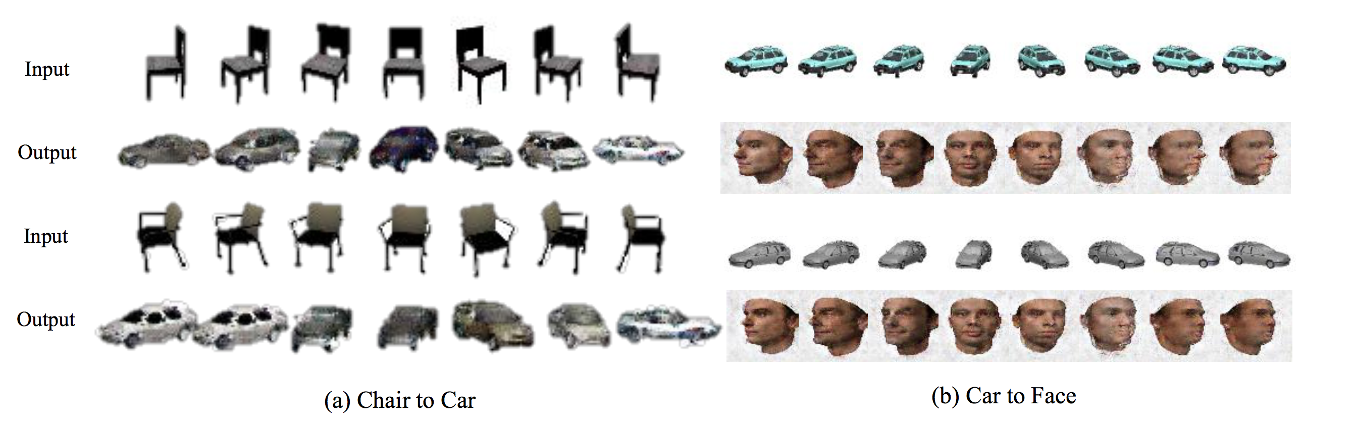
DiscoGAN
Learning to Discover Cross-Domain Relations with Generative Adversarial Networks

Slide 12
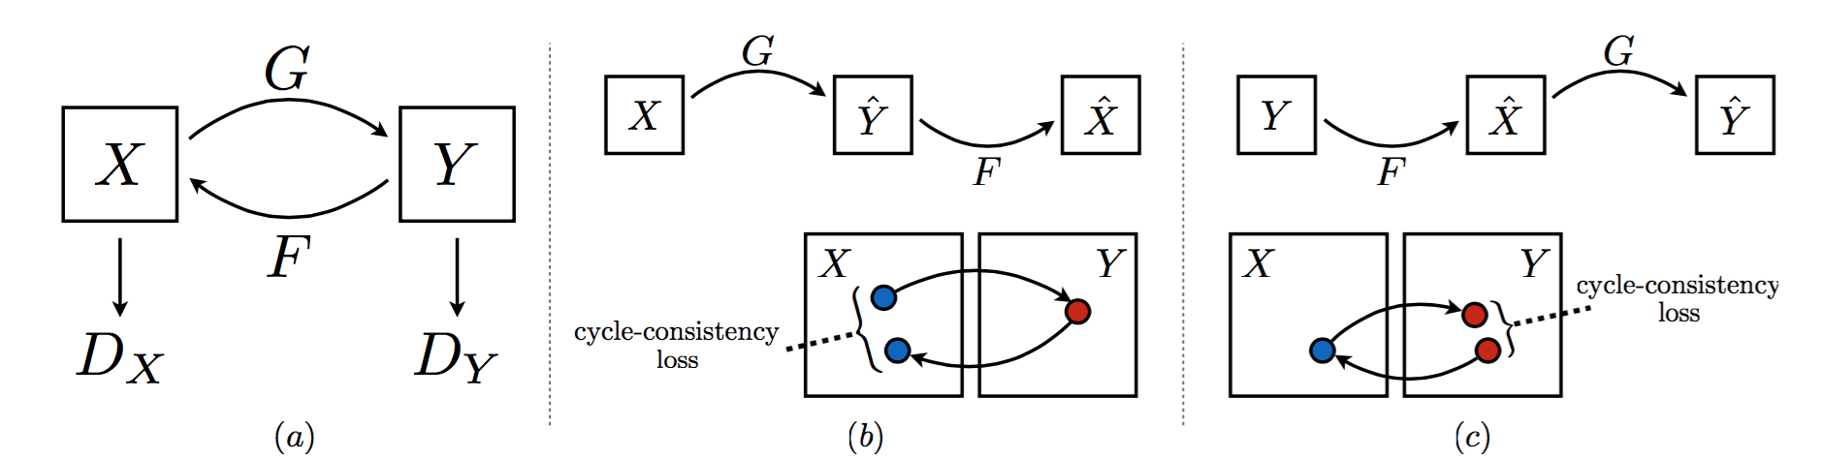
CycleGAN
Unpaired Image-to-Image Translation using Cycle-Consistent Adversarial Networks

Slide 13
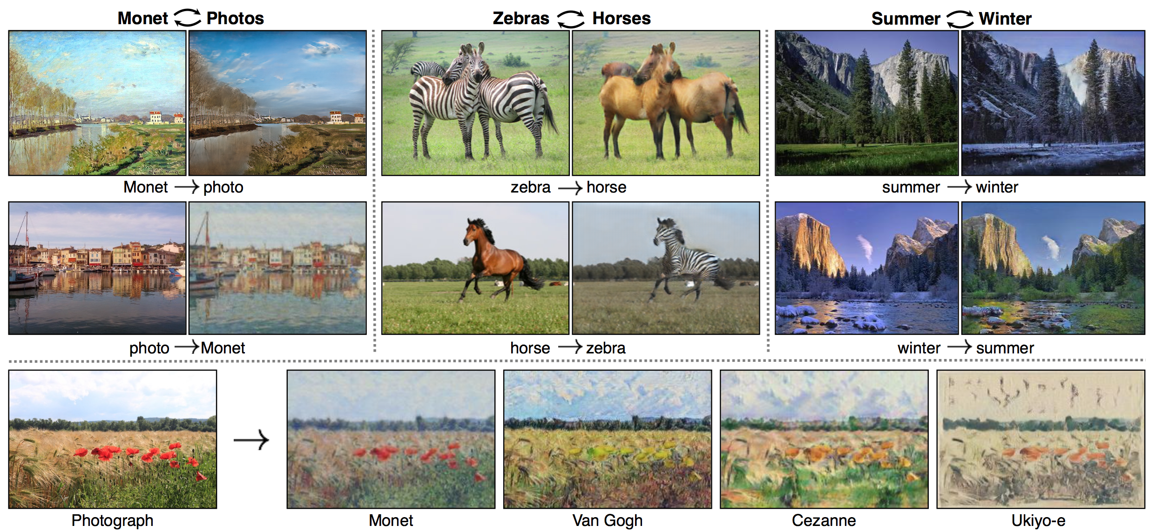
CycleGAN
Unpaired Image-to-Image Translation using Cycle-Consistent Adversarial Networks

Slide 14
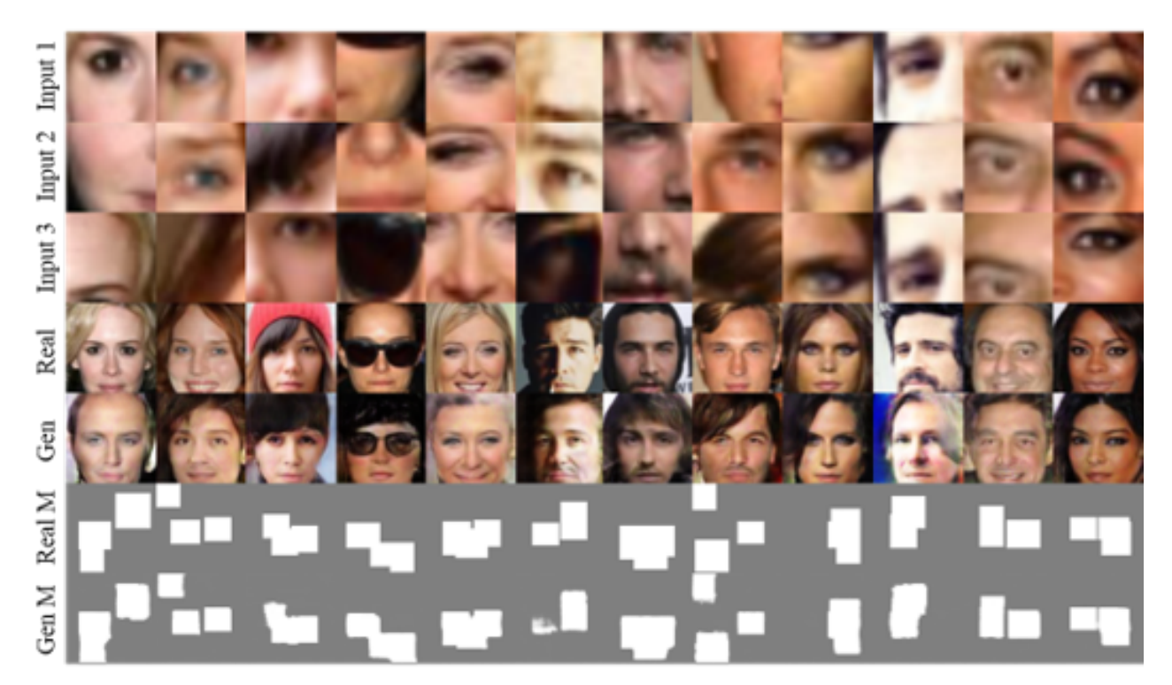
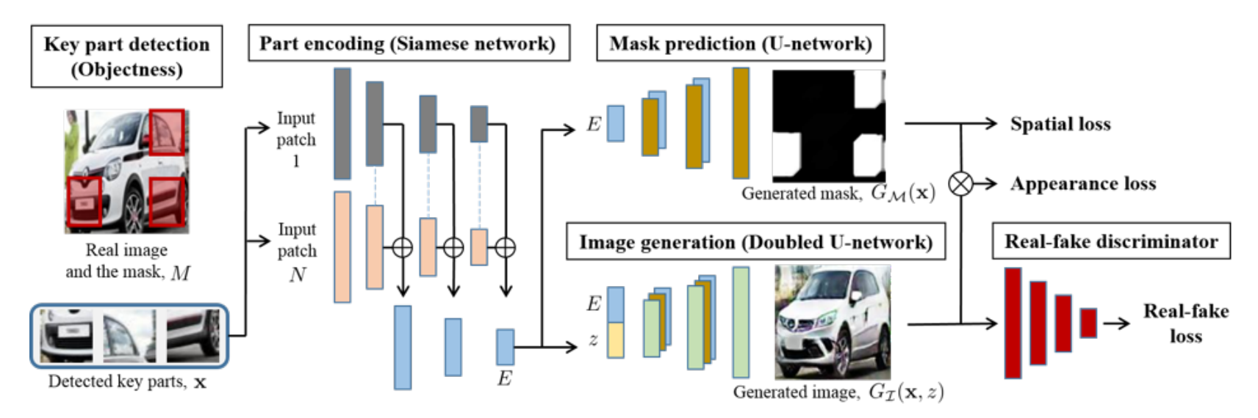
Holistic Image Generation
Unsupervised Holistic Image Generation from Key Local Patches

